Slide 1
Analysis of Brooklyn Neighborhoods
Deciding where to open a new vegetarian/vegan restaurant

Slide 2
Introduction and problem definition
New food habits all around the world → More demand for vegetarian and vegan restaurant options
Numerous new restaurants are closing within a year time of opening
GOAL: evaluation of different neighborhoods in Brooklyn, NY to determine the most suitable for the opening of a new vegetarian/vegan restaurant
Interested parties: people in the restaurant business

Slide 3
Data acquisition and cleaning
Data Source: Foursquare data and web available data about new york boroughs and neighborhoods
Data cleaning:
Filtering of New York dataset to obtain only Brookyn data
Extraction of Foursquare data on Brooklyn neighborhoods, for top venues and location data

Slide 4
Methodology
Brooklyn dataset used to get Frousquare dataset
Calculation of correlation between the presence of vegetarian/vegan restaurants and other venue categories
Clustering of the neighborhoods to find the ones with the appropriate target venues
Analysis of each clustering to select the right one

Slide 5
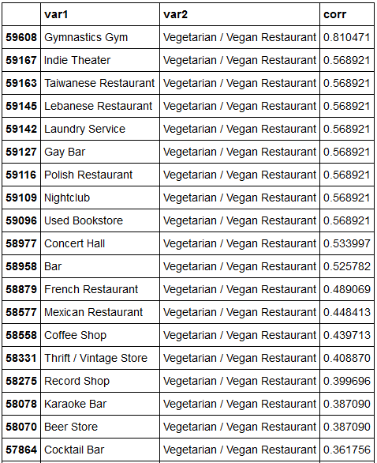
Results
Calculation of correlation:
The highest correlation obtained with the presence of vegetarian/vegan restaurants are gymnastic gym.
Other correlation values are not significant enough to select target venues this way.

Slide 6
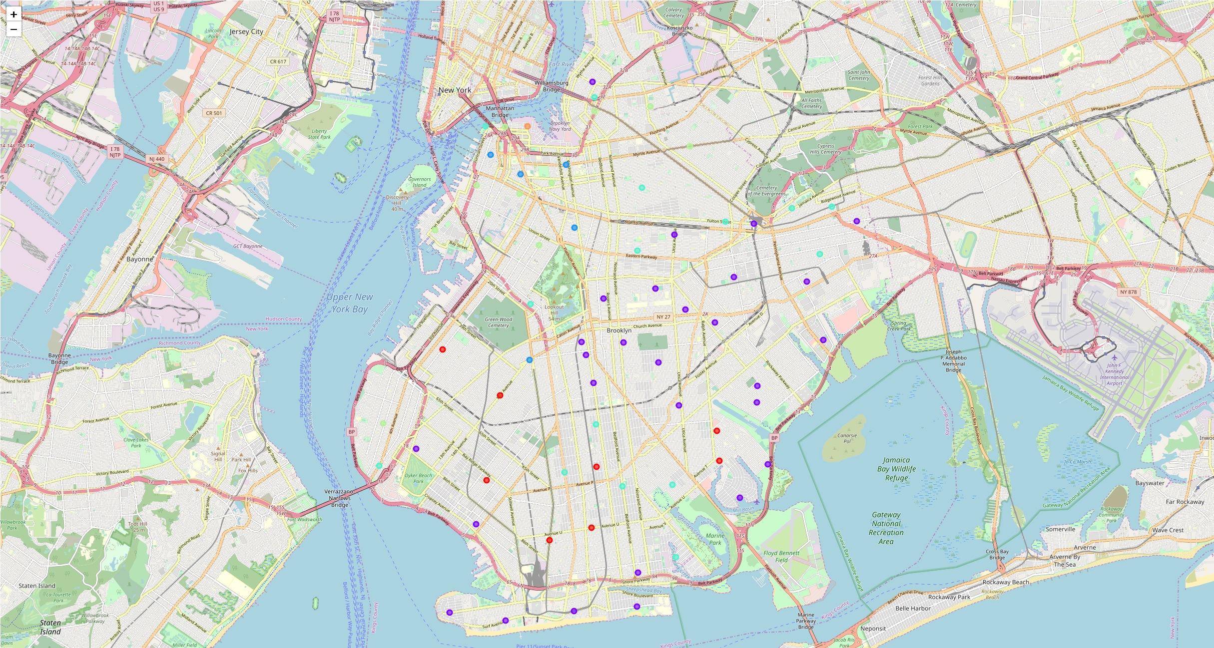
results
Nearest-neighbor clustering : 6 clusters of neighborhoods
Cluster 1: a single neighborhood cluster, combining a lot of types of restaurants (Turkish, sandwich place, pizza, Russian, Chinese, etc.).
Cluster 2: four neighborhoods, with tops venues that are either banks, pizza places, Asian restaurants or pharmacy.
Cluster 3: 35 neighborhoods cluster, mostly exotic restaurants (Thai, Japanese, Chinese) but also a lot of different places for coffee or quick food stops.
Cluster 4: 17 neighborhoods cluster, the mains venues of the top five are spas, pizza places and bars.
Cluster 5: 10 neighborhoods cluster. Coffee shops, Caribbean restaurants, ice cream shops, donut shops and pizza places are the most present venues in the top five.
Cluster 6: 3 neighborhoods cluster. All three have a yoga studio in the top five venues as a common denominator.

Slide 7
Discussion
No Correlation between vegetarian/vegan restaurants and other venues
Hypothesis: vegetarians or vegans tend to like certain lifestyles and the other way around, people that like certain activities like vegetarian food more than others
New target venues: Yoga Studios, Pilates Studios, Art venues, sports venues
Cluster 6 → common venue = Yoga Studios, cluster of choice

Slide 8
Discussion
Brooklyn Heights :
Most popular venue = Yoga Studio
In the first five venues : a park (jogging and outside activities), a coffee shop, a scenic lookout and a pet store.
In the ten most popular venues : a pilates studio
In 15 top venues, only three are restaurants and none are vegetarian or vegan restaurant
Clinton Hills :
Yoga Studio as the third top venue of the neighborhood
In the top 5, three venues are restaurants → already some competition
In top 15 venues, 8 of the venues in total are restaurants and without other types of venues that we are targeting here.
Dumbo :
Most popular venue = Yoga Studio
Second most popular venue is an Art gallery (target venue)
In the top : an Antique Store and a Bookstore, attracting artistic and hipster clientiele.
A Boxing Gym, Gym and a Climbing Gym present
The only options for food in the top venues are a Bakery, a Salad Place and a Sandwich place

Slide 9
Conclusion
Based on clustering and data analysis of the venues of all Brooklyn neighborhoods, the recommended neighborhood for the openning of a vegetarian/vegan restaurant is Dumbo.

